Slide 1
4
INTEGRALS
Copyright © Cengage Learning. All rights reserved.

Slide 2
4.5
The Substitution Rule
Copyright © Cengage Learning. All rights reserved.

Slide 3


The Substitution Rule
Because of the Fundamental Theorem, it’s important to be able to find antiderivatives. But our antidifferentiation formulas don’t tell us how to evaluate integrals such as
To evaluate this integral our strategy is to simplify the integral by changing from the variable x to a new variable u.
Suppose that we let u be the quantity under the root sign in
u = 1 + x².
Then the differential of u is du = 2x dx.

Slide 4


The Substitution Rule
Notice that if the dx in the notation for an integral were to be interpreted as a differential, then the differential 2x dx would occur in and so, formally, without justifying our calculation, we could write

Slide 5

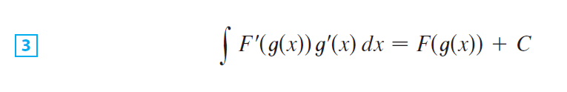
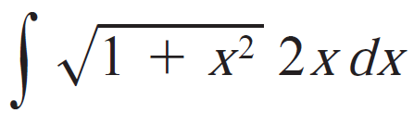
The Substitution Rule
But now we can check that we have the correct answer by using the Chain Rule to differentiate the final function of Equation 2:
In general, this method works whenever we have an integral that we can write in the form

Slide 6


The Substitution Rule
because, by the Chain Rule,
If we make the “change of variable” or “substitution”
u = g(x), then from Equation 3 we have
or, writing F’ = f, we get

Slide 7
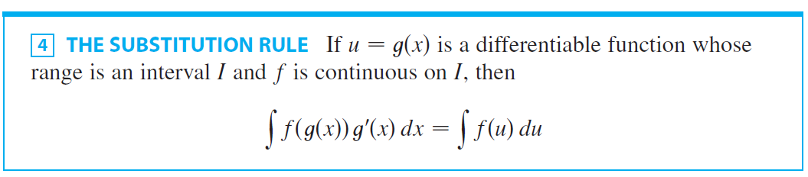

The Substitution Rule
Thus we have proved the following rule.
Notice that the Substitution Rule for integration was proved using the Chain Rule for differentiation. Notice also that if
u = g(x), then du = g’(x)dx, so a way to remember the Substitution Rule is to think of dx and du in as differentials.
The Substitution Rule says: It is permissible to operate with dx and du after integral signs as if they were differentials.

Slide 8





Example 1
Find
Solution:
We make the substitution u = x⁴ + 2 because its differential is and the Substitution Rule, we have
Notice that at the final stage we had to return to the original variable x.

Slide 9


The Substitution Rule
The idea behind the Substitution Rule is to replace a relatively complicated integral by a simpler integral. This is accomplished by changing from the original variable x to a new variable u that is a function of x.
Thus in Example 1 we replaced the integral
by the simpler integral
The main challenge in using the Substitution Rule is to think of an appropriate substitution.

Slide 10
The Substitution Rule
You should try to choose u to be some function in the integrand whose differential also occurs (except for a constant factor). This was the case in Example 1.
If that is not possible, try choosing u to be some complicated part of the integrand (perhaps the inner function in a composite function).
Finding the right substitution is a bit of an art. It’s not unusual to guess wrong; if your first guess doesn’t work, try another substitution.

Slide 11




Example 2
Evaluate
Solution:
Solution 1 Let u = 2x + 1. Then du = 2 dx, so dx = du.
Thus the Substitution Rule gives

Slide 12

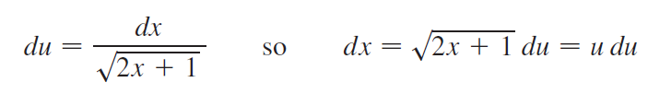


Example 2 – Solution
cont’d
Solution 2 Another possible substitution is
Then
(Or observe that u² = 2x + 1, so 2u du = 2 dx.)
Therefore

Slide 13


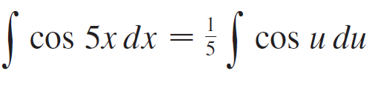

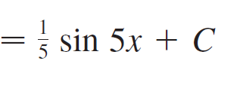
Example 4
Calculate
Solution:
If we let u = 5x, then du = 5dx, so dx = du. Therefore

Slide 14

The Substitution Rule
NOTE With some experience, you might be able to evaluate integrals like these without going to the trouble of making an explicit substitution.
By recognizing the pattern in Equation 1, where the integrand on the left side is the product of the derivative of an outer function and the derivative of the inner function, we could work Example 1 as follows:

Slide 15

The Substitution Rule
Similarly, the solution to Example 4 could also be written like this:

Slide 16
The Substitution Rule
for Definite Integrals

Slide 17
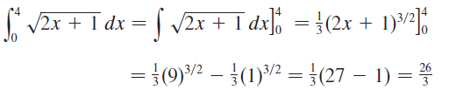
Definite Integrals
When evaluating a definite integral by substitution, two methods are possible.
One method is to evaluate the indefinite integral first and then use the Evaluation Theorem.
For instance, using the result of Example 2, we have

Slide 18
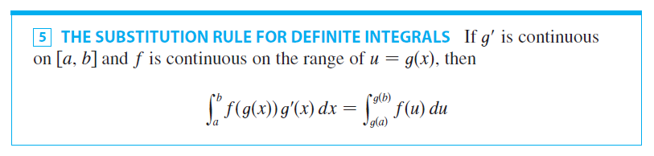
Definite Integrals
Another method, which is usually preferable, is to change the limits of integration when the variable is changed.
This rule ways that when using substitution in a definite integral, we must put everything in terms of the new variable u, not only x and dx by also the limits of integration.
The new limits of integration are the values of u that correspond to x = a and x = b.

Slide 19
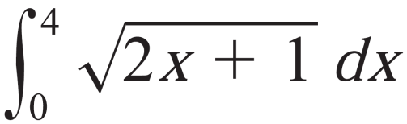
Example 5
Evaluate
Solution:
Using the substitution from Eg.2, we have u = 2x + 1, and then du = 2 dx, so dx = ½ du.
To find the new limits of integration we note that
when and
when

Slide 20
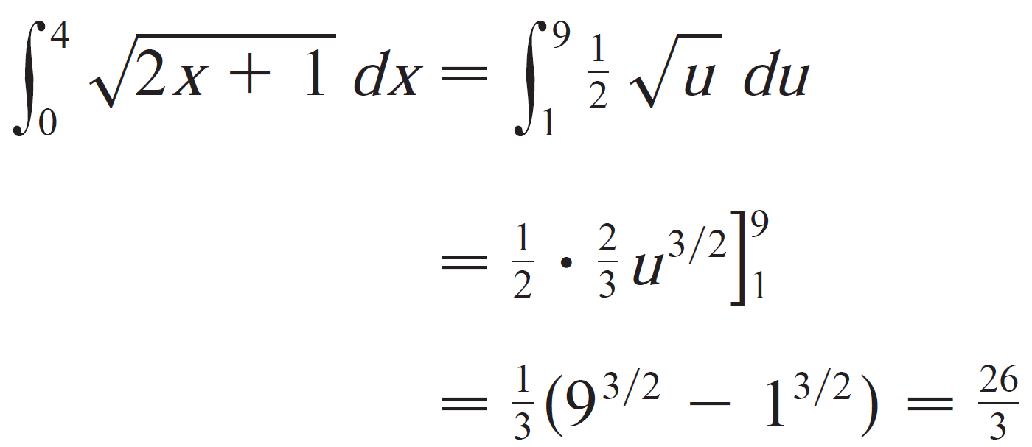
Example 5 – Solution
Therefore

Slide 21



Example 6
Evaluate
Solution:
Let u = 3 – 5x. Then du = –5 dx, so dx = du.
To find the new limits of integration we note that
when and when

Slide 22





Example 6 – Solution
Therefore

Slide 23
Definite Integrals
cont’d
Observe that when using we do not return to the variable x after integrating.
We simply evaluate the expression in u between the appropriate values of u.

Slide 24
Symmetry

Slide 25
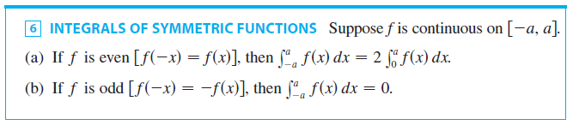
Symmetry
The next theorem uses the Substitution Rule for Definite Integrals to simplify the calculation of integrals of functions that possess symmetry properties.

Slide 26
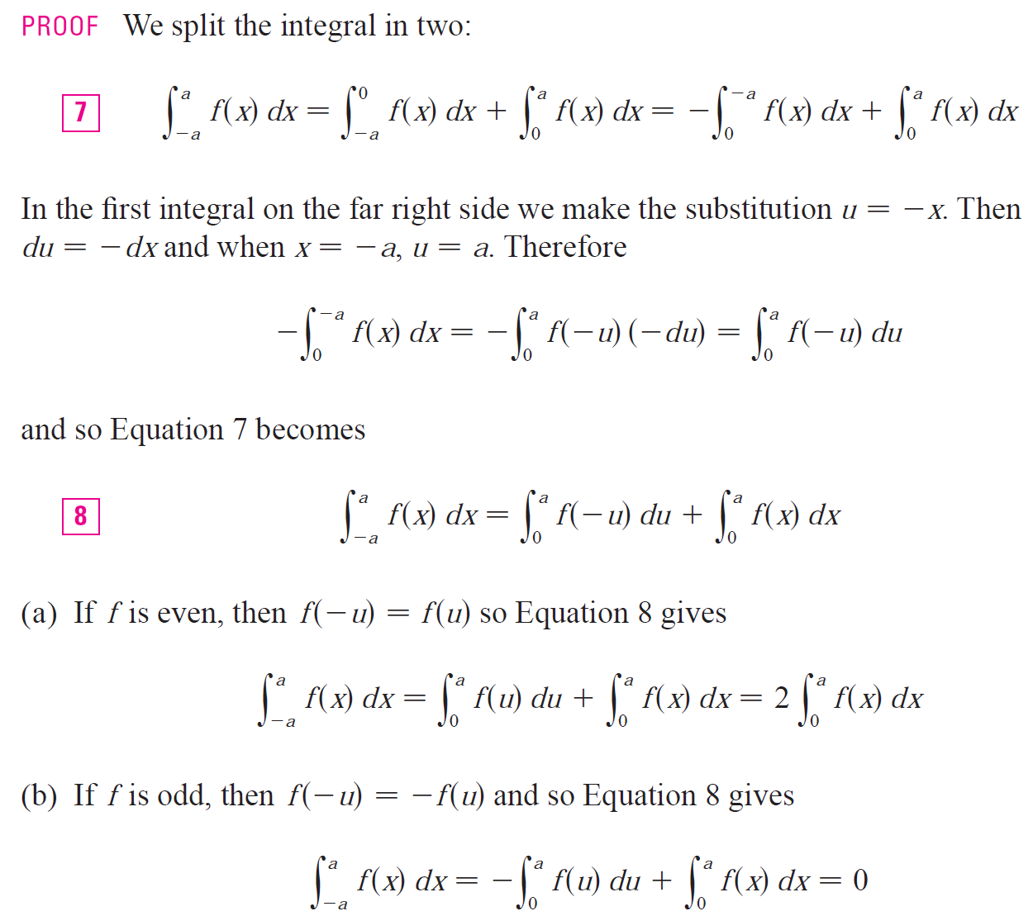
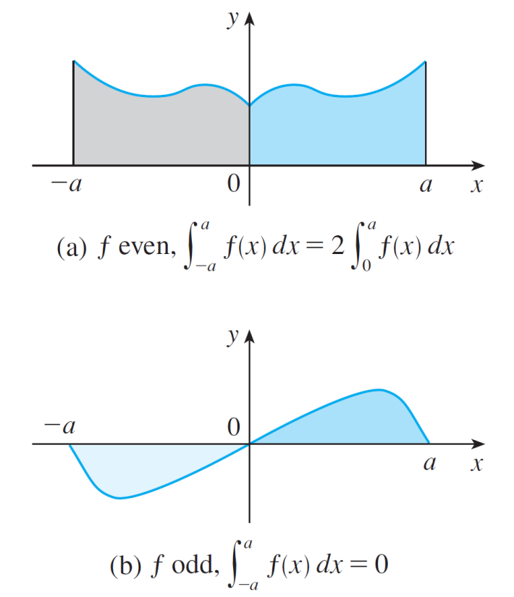
Symmetry
Theorem 6 is illustrated by Figure 2.
Figure 2

Slide 27

Symmetry
For the case where f is positive and even, part (a) says that the area under y = f (x) from –a to a is twice the area from 0 to a because of symmetry.
Recall that an integral can be expressed as the area above the x-axis and below y = f (x) minus the area below the axis and above the curve.
Thus part (b) says the integral is 0 because the areas cancel.

Slide 28
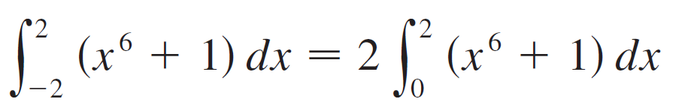

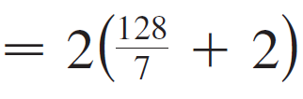
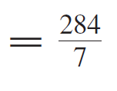
Example 7
Since f (x) = x⁶ + 1 satisfies f (–x) = f (x), it is even and so

Slide 29
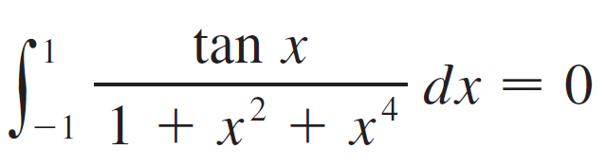
Example 8
Since f (x) = (tan x)/(1 + x² + x⁴) satisfies f (–x) = –f (x), it is odd and so

Slide 30
Trigonometric Substitutions

Slide 31
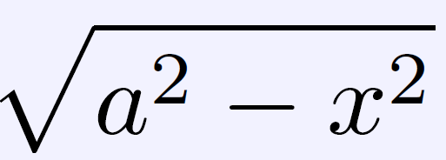
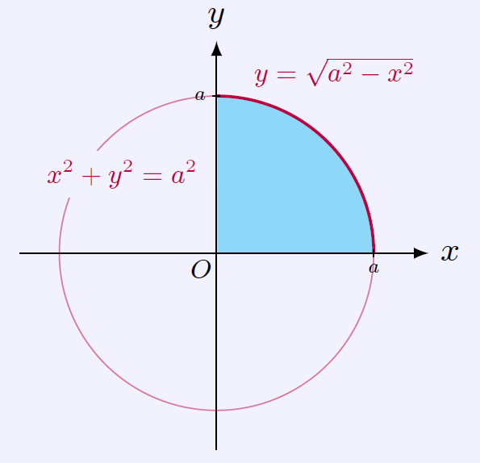
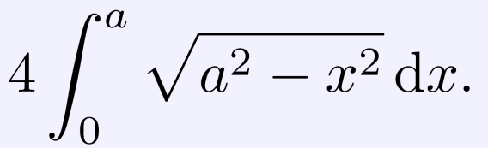

Example 9: integrals involving
Find the area of a circle of radius a.
Solution: The area of the circle equals four time the area of the part of the circle in the first quadrant. Therefore, we need to calculate the integral
In order to remove the radical in the
Integrals, we use the trigonometric
substitution for integrals involving
.

Slide 32
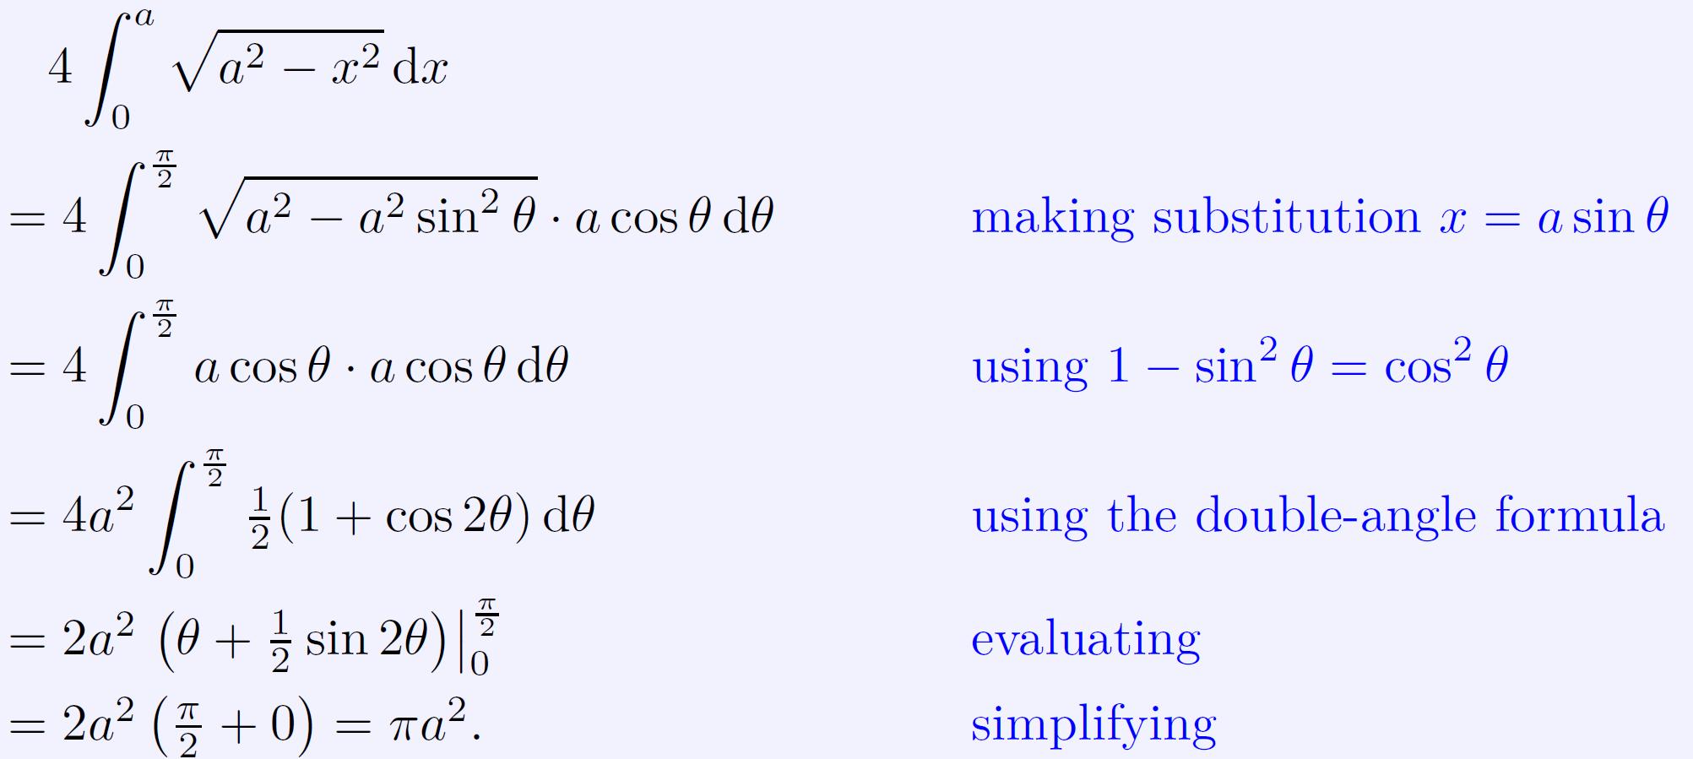
Example 9: integrals involving
Let x = a sinθ, then dx = a cosθ dθ.
When x = 0, θ = 0; when x = a, θ = π/2.
Hence,

Slide 33
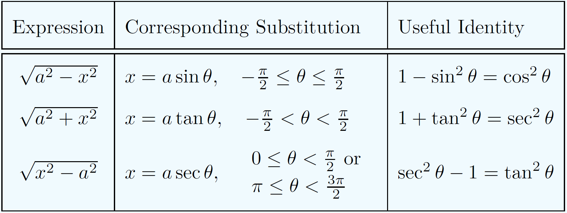
Trigonometric Substitutions
Table for trigonometric substitutions

Slide 34
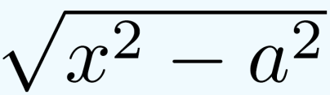
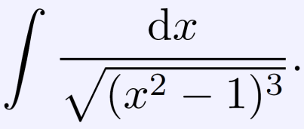
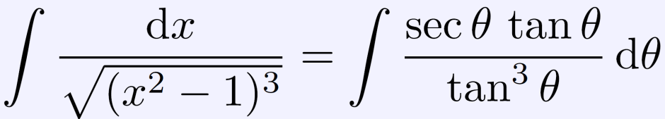
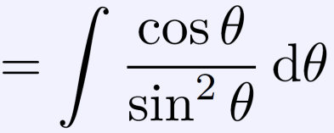
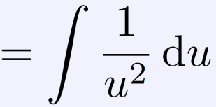

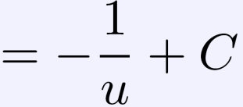
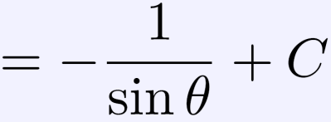
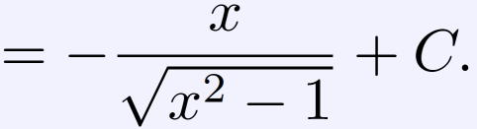

Example10: integrals involving
Evaluate the integral
Solution: In order to remove the radical in the Integrals, we use the trigonometric substitution x = secθ. Then we have
Thus,

Slide 35
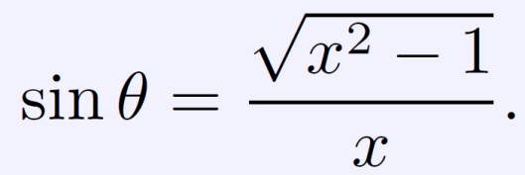
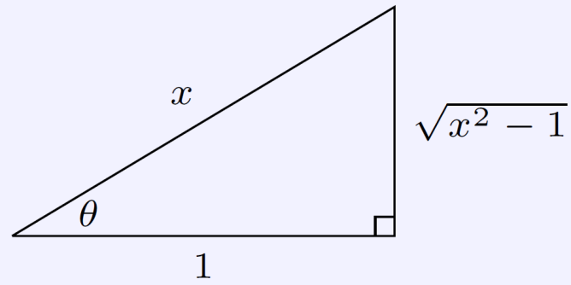
Example10: integrals involving
Here in the last step (change variable from θ to x), we use the following formula:
Because x = secθ:

